Slide 1

HOW TO START AN ICSID ARBITRATION
THE REQUEST FOR ARBITRATION

Slide 2
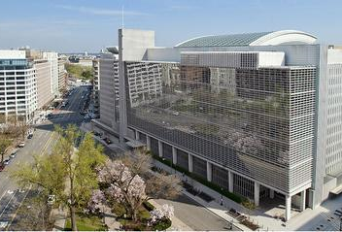

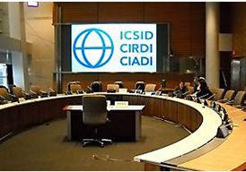
International Centre for Settlement of Investment Disputes
(ICSID)

Slide 3
ICSID Convention
Institution Rules and Administrative and Financial Regulations
Arbitration Rules
Procedural Orders
Instrument of consent to arbitration
Applicable rules of procedure
To an ICSID arbitration

Slide 4
Instruments of consent to arbitration
TREATY
CONTRACT
NATIONAL LAW

Slide 5
The instrument of consent to arbitration can:
Delimit the scope of the dispute
Provide additional procedural requirements (cooling-off period; method to appoint the tribunal; etc.)

Slide 6
ICSID CONVENTION
ARTICLE 36:
Request for arbitration in writing to the Secretary-General
Information about the dispute, the parties and their consent to arbitration
The request is registered, unless the dispute is manifestly outside the ICISD jurisdiction

Slide 7
Institution Rules
Administrative and Financial Regulations
Rule 1
Rule 2
Regulation 16
Regulation 30
Regulation 34
Rule 3
Rule 4

Slide 8
Administrative and Financial Regulations
Regulation 16. Non-refundable Lodging Fee of US$ 25,000 paid on filing the request
Regulation 30. Supporting Documentation: number of copies; originals; certified translations
Regulation 34. Official languages of the Centre: English, Spanish, French

Slide 9
Institution Rules
Rule 1. In writing to the Secretary-General; in an official language of the Centre, dated and signed by requesting party or duly authorized representative.
Rule 2. Contents of the Request: parties, counsels, contact details; date of consent and instrument where it is recorded; nationality of the requesting party; legal dispute arising directly out of an investment; internal actions to authorize it; + supporting documentation
Rule 3. Additional information, e.g. regarding number of arbitrators and method of appointment
Rule 4. 1 original + 5 signed copies

Slide 10
Arbitration Rules
Establishment of the Tribunal
Agreement between the parties regarding the number of arbitrators (see conditions of their nationalities), the method of their appointment (Rule 1)
No previous agreement, then proposals regarding the number of arbitrators and the method of their appointment; No agreement reached at any time 60 days after the registration of the request, then default mechanism as per Article 37.2.b ICISD Convention (Rules 2 and 3)
No agreement reached as to the president of the tribunal within 90-day of the notice of registration of the request, the Chairman of the ICISD Administrative Council (= the President of the World Bank) appoints the arbitrator or arbitrators not yet appointed (Rule 4 and Article 38 ICSID Convention)

Slide 11
When is consent to arbitration perfected?
if in a contract clause: when the contract comes into effect between the parties
If in a treaty provision: when the claimant accepts the standing offer of the host State to arbitrate their dispute

Slide 12
Procedural Orders
Rule 19: Orders issued by the tribunal for the conduct of the proceedings

Slide 13
Structure of the Request for Arbitration
1. Introduction
2. Parties and Counsel
3. Factual background a.k.a. summary of the legal dispute
4. Fulfilment of Jurisdictional and Procedural requirements
5. Constitution of the Tribunal
6. Relief sought
7. Date and signature

Slide 14
Structure of the Request for arbitration 1/7
Introduction
“Pursuant to Article 36 of the ICSID Convention, the [NAME OF THE CLAIMANT] hereby submits its request to the Secretary-General ICSID to institute an ICSID arbitration against the [NAME OF THE RESPONDENT STATE] under the [NAME OF THE LEGAL INSTRUMENT PROVIDING FOR CONSENT TO ARBITRATION + evidence of its entry into force].”

Slide 15
Structure of the Request for arbitration 2/7
Parties and Counsel
- Name and contact details of all parties and counsels;
- state if the respondent is a constituent subdivision or agency of a State designated to ICSID by that the State pursuant to art. 25 ICISD Convention;
- date of consent and instrument in which it is recorded;
- Nationality of the requesting party on the date of consent, declaring it doesn’t have the nationality of the respondent state (when natural person);
- evidence that the respondent state agreed to treat the claimant as a national of another State (when claimant is juridical person incorporated in the respondent state);
- all necessary internal actions taken (when juridical person);
- power of attorney for counsel;
+ supporting documentation

Slide 16

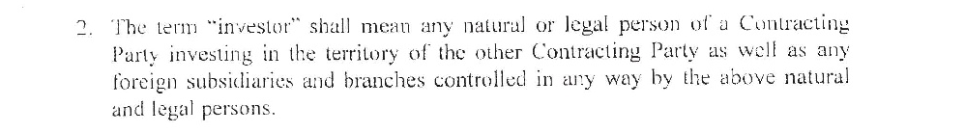

Slide 17
Structure of the Request for arbitration 3/7
Factual background a.k.a. summary of the legal dispute
Claimant’s investment, Measures adopted by the Respondent affecting the investment, Respondent’s breaches under the relevant treaty/contract/national law

Slide 18
Structure of the Request for arbitration 4/7
Fulfilment of Jurisdictional and Procedural requirements
under Art. 25 ICSID Convention as well as the legal instrument of consent to arbitration

Slide 19
Structure of the Request for arbitration 5/7
Constitution of the Tribunal
party-appointed arbitrator, method for appointing the rest of the tribunal and its deadline (Institution Rule 3, Arbitration Rules 1 to 4)

Slide 20
Structure of the Request for arbitration 6/7
Relief sought
pecuniary remedy and specific performance
+ reservation of rights

Slide 21
Structure of the Request for arbitration 7/7
Date and signature
signed by the requesting party or its duly authorized representative

Slide 22

Requesting Party files a Request for Arbitration to the Secretary-General and pays 25,000 $
Secretary-General screens the Request
Number of Arbitrators and the
Method of their Appointment are
Established
Tribunal Members are Appointed
Tribunal is Constituted and the
Proceeding Begins
Secretary-General registers the Request and gives notice of registration to the Parties
Flow chart of the Institution of the Proceedings
Dispute manifestly outside the jurisdiction of ICSID: Refusal of registration
2-3 weeks
60
days
90
days

Slide 23
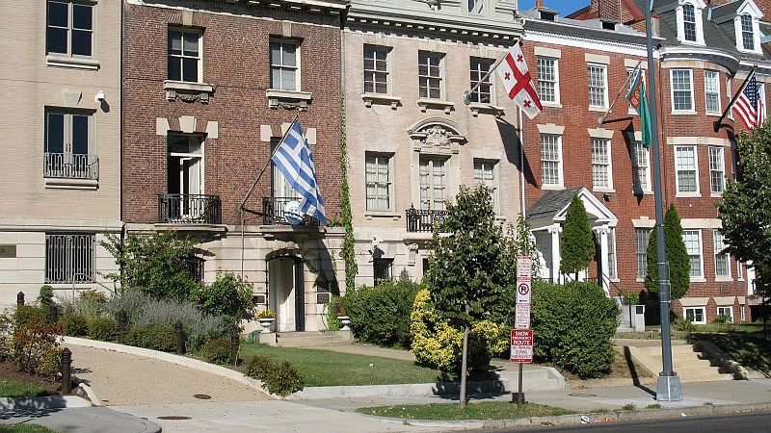
"Embassy Row" in Washington, D.C where most of embassies and diplomatic missions are concentrated

Slide 24
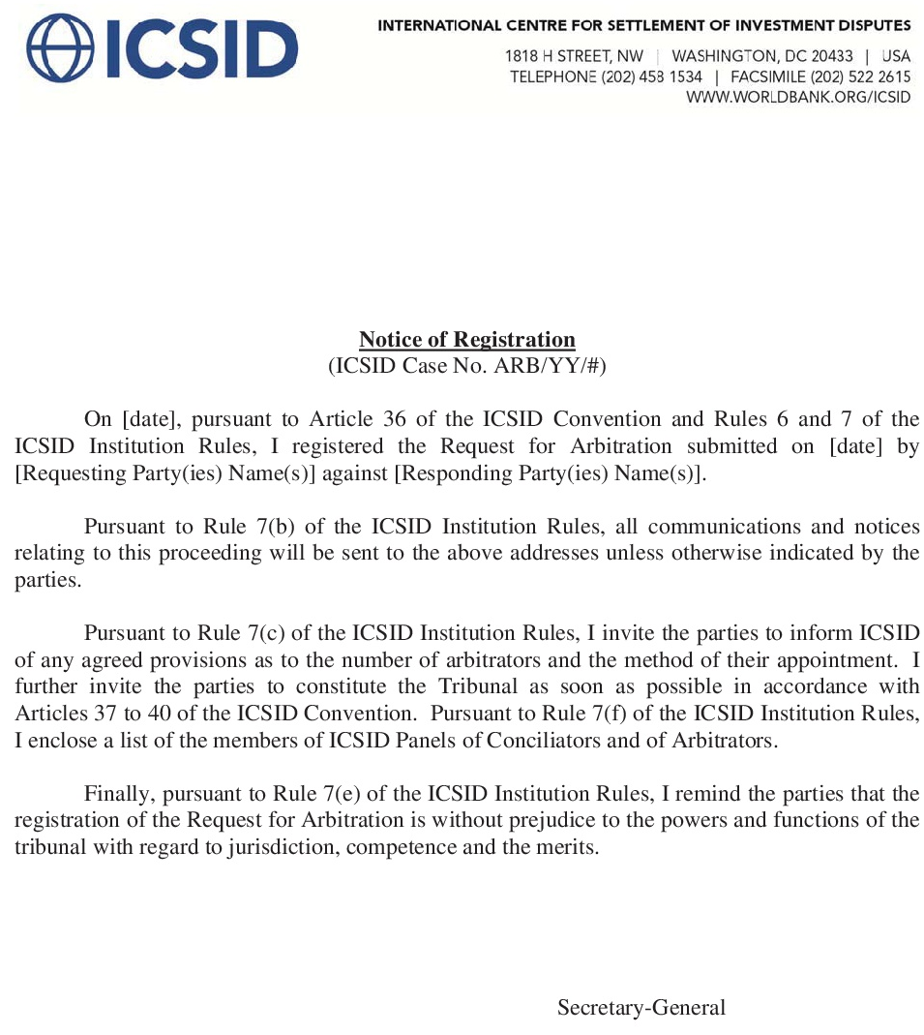
Template of the notice of registration of a Request for an ICSID arbitration

Slide 25
Thank you!
Danilo Ruggero Di Bella
Bottega Di BELLA
www.bottegadibella.com
danilo.dibella@bottegadibella.com

